Slide 1
President’s Report 20 October 2016

Slide 2
Intercampus Faculty Council (IFC)
Post Tenure Review Policy with CRR revision
Initiated partly in response to MO legislature criticisms
Integrate workload, annual review, PTR, and waiver, policies
Tom Schuman is the campus IFC representative for PTR review
Proposed CRR changes are posted for comments
IFC seeking comment on proposed CRR changes
Redline and IFC informational white paper posted
http://facultysenate.mst.edu/media/campussupport/facultysenate/documents/presidentreports/2016/PTR%20Task%20Force%20White%20Paper_10.04.2016.pdf
Seek approval of System Faculty Senates (our November meeting)

Slide 3
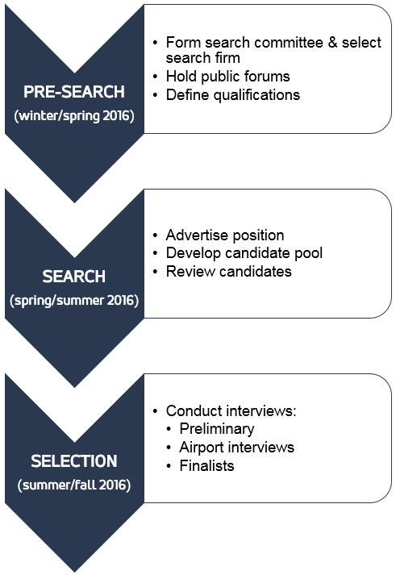
Campus
Information on the UM System President search:
https://www.umsystem.edu/ps
Campus representative – C. Joe Boehm (staff rep)
Finalists interviewed prior to BOC meeting, 4-5 October
Negotiation phase
Anticipated completion in ~3 wk

Slide 4
UM System - Finance
2nd withholding by Governor is constraining budget
Try to congeal UM System back to single budget
Retained Moody “stable” rating
New “Finance Academy” offered for academicians
Deans
Chairs
Leadership Development Program alums
New spousal travel reporting and approval law

Slide 5
Computer Security
Increased security attacks
System CIO is changing computing policies
Increase filter sensitivity
Implement ‘secure authentication toolkit’
Commonly used in commercial (e.g., Google or Amazon) logins
2 factor login: password + PIN sent as text or via another device
Will see initially for personal data access: HR info, HIPA, other…
IT purchasing policy drops minimum value to $0
Issue with purchase/installation of inherently insecure items
Requires central IT approval for all software and hardware purchases
Approvals conveyed by local CIO or designee

Slide 6
Campus
Committee elections were held 21 April meeting
Unfilled committee positions
Additional nominees not forthcoming
Under today’s agenda item (RP&A)
Missing alternate for Grievance Resolution Panel
Resignation by FS CCC representative (one member)
Facilities Planning, from and by FS (one member)
Library and Learning Resources (1 yr term, from FS)
Parking, security, and traffic (2 positions by FS)
Academic Freedom and Standards Committee*
Conflict of interest committee*
* has nominee

Slide 7
Campus
Female faculty campus climate report (Dec 2015)
Results are posted on Provost website, login protected
https://provost.mst.edu/media/administrative/provost/secure/2015_MST_FINAL_REPORT (002).pdf
Collaborative on Academic Careers in Higher Education (COACHE) Survey
Results were presented to campus by Dr. Mormile
Well below all other (of 89) colleges’ results on 6 categories
Leadership: (senior, divisional)
Governance: (trust, shared purpose, understanding issues, adaptability)
Top 30%: Tenure expectations (clarity); Leadership: Faculty

Slide 8
Internationalization Committee
Seeking Standing Committee status
Proposed by Dr. Wray of International and Cultural Affairs (OICA)
Dr. Fitch and I met Tuesday 18 Oct with Dr. Wray, Drs. Bohner and Allada
Concerned with overlap with existing standing committees
Budget prioritization
Need for funding in OICA
Drop in student fee revenue from OPeC/oil industry sources
Created crisis in lack of OICA staff
OICA serves a still-large international student population
Consideration to be on agenda for FS in November

Slide 9
Campus Issues (Not Exhaustive…)
Bylaws changes and Dean search process
IBIS visited 18 Oct 16
Cap enrollment, for specific departments
Graduate student tuition remission
‘Fund’ the colleges, i.e., Deans; define fiduciary responsibilities – funding increased by 10x
Most faculty line ownership to Dean’s level
Shared governance in changes to strategic plan
Search Process for next VP and Dean of CEC

Slide 10
Chancellor Meetings with CEC/CASB Dept.s
Listening sessions occurred
21 – 22 Sept 16 CEC
17 – 18 Oct 16 CASB
David Russell
Dr. Middleton’s COS
Sitting in: observe and represent System
Faculty opportunity
Point out broken systems
Point out solutions to broken systems
Identify common threads for discussion
Generate points for facilitated discussion

